Slide 1
Topic: Image Captioning
李彤
2019.10.22

Slide 2
Outline
1. Introduction
2. Computer Visual
3. Method

Slide 3
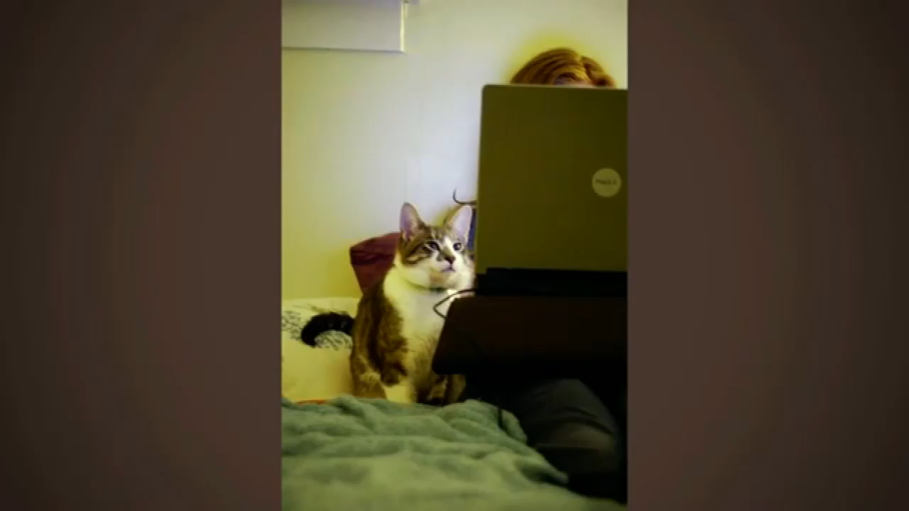
Introduction

Slide 4
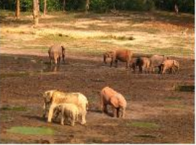

Introduction
Major: Computer science and technology
Direction: Image Captioning
A herd of elephants walk across a dry grass field

Slide 5
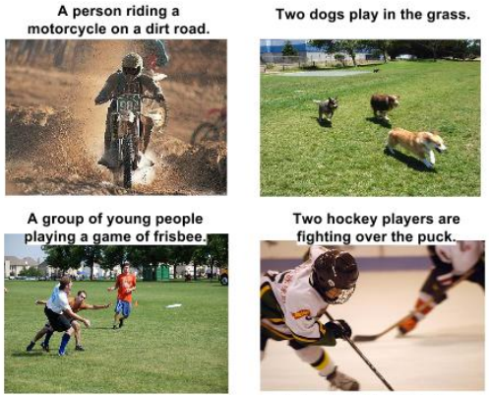
Introduction

Slide 6
Introduction
help visually impaired people better understand the content of images
facilitate quick retrieval of images
Impacts

Slide 7

Computer Visual
“see”

Slide 8
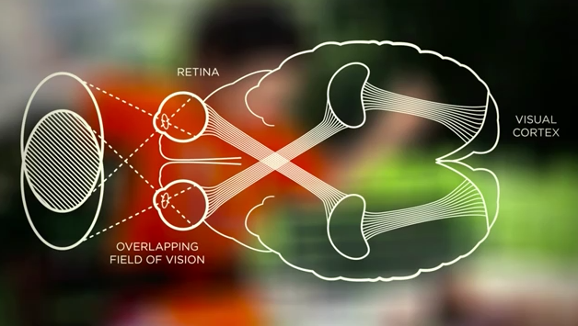
Computer Visual
“understand”

Slide 9
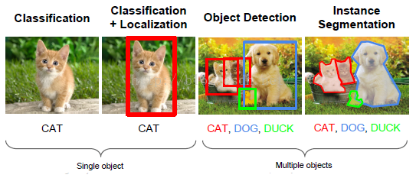
Computer Visual
Basic Tasks:

Slide 10
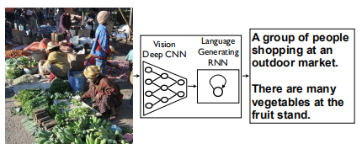
Method
Encoder-Decoder

Slide 11
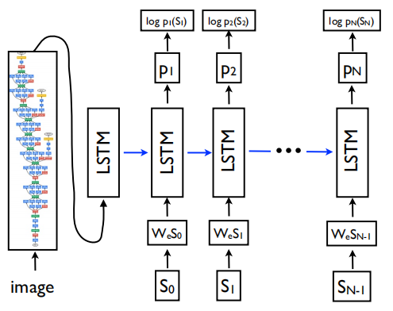
Method
Show and Tell: A Neural Image Caption Generator
Oriol Vinyals et al., 2015

Slide 12
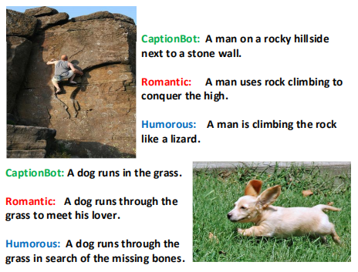
Style Captions Example

Slide 13
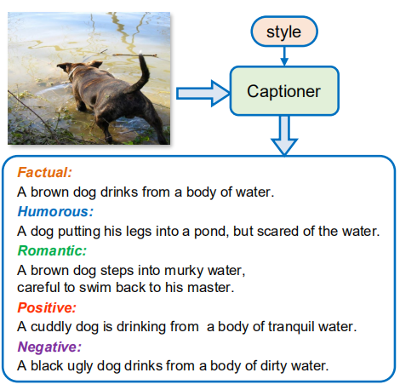
MSCap
MSCap: Multi-Style Image Captioning with Unpaired Stylized Tex
Longteng Guot et al., 2019

Slide 14
END TNANKS

Slide 15
演讲稿
Hello everyone, the topic I want to share today is "Image Captioning". Next, I will introduce the following three aspects.
First, let me show you something. This video clip is from the ted speech of Li Feifei in 2015. This is a three-year-old child describing what she sees in a series of photos. She might still have a lot to learn about this world, but she's already an expert at one very important task: to make sense of what she sees. But this is still a challenge for computers.
Next, let me give you a brief introduction. My major is Computer science and technology, and my direction is the image captioning. The task is to let the computer understand the semantic information of the picture. Generally speaking, it is to look at a picture and return a sentence to describe the picture. As shown in the slide, input is a picture, then computer processes the picture and outputs a sentence. These are some other examples. Of course, computers sometimes go wrong. There are three dogs on the picture, but the computer thinks there are only two, probably because this dog is too small, and the computer ignores it.
Of course, this task have great impacts, for example, it can help visually impaired people better understand the content of images on the web and It facilitates quick retrieval of images.
Because this task is one of the main goals in the field of computer vision, let me briefly introduce computer vision. Computer vision is a science that studies how to make a computer "see". But for computers, the picture is just a bunch of pixels —— a set of meaningless numbers. So, We not only need to let the computer see the picture, but we also need to let it understand the picture, just like our brain.
The following figure shows the four basic tasks in the field of computer vision. The first is the image classification. The goal is to output the category of the given image, such as a cat. The second is object localization, not only to identify what type of object, but also to give the location of the object. The third is object detection, which needs to detect the category and location information of multiple objects. The last one is instance segmentation, which is the process of tagging each pixel in an image, that is, pixel-level segmentation.
The last part: Method of image captioning. In this field, the most basic method is based on encoder and decoder. We use a convolutional neural network as the encoder to encode the image and extract the global feature vector of the image. And we use a recurrent neural network as the decoder. The decoder receive the feature vector, and translate it into a sentence to describe the picture.
This is the NIC model proposed in 2015. We can see that a CNN encode a image, and a LSTM decode that. And, the LSTM is a kind of RNN.
Next, I want to talk about another application. When we use social software to upload images, it helps us automatically generate stylized descriptions that can get more people's attention. This will bring us great convenience. For example, a romantic style caption: A man uses rock climbing to conquer the high. This is the latest paper on stylized descriptions this year. This method is cool, but it is too professional, so I won't go into detail about its structure. Simply, it accepts a picture and the style you want, generating a corresponding stylized description.

